Slide 1
















Team Pattern hunters
A DPBH 2024 Project

Slide 2


What is a dark pattern?
A dark pattern is a deceptive UI or text-based strategy to influence customer behavior for personal gains.
Examples
Disguised ads
Forced continuity
Hidden costs
WHY ARE DARK PATTERNS A CAUSE OF CONCERN?
Dark patterns are generally considered unethical and can lead to a poor user experience. They exploit psychological tendencies and expectations to guide users toward choices that may not be in their best interest.

Slide 3

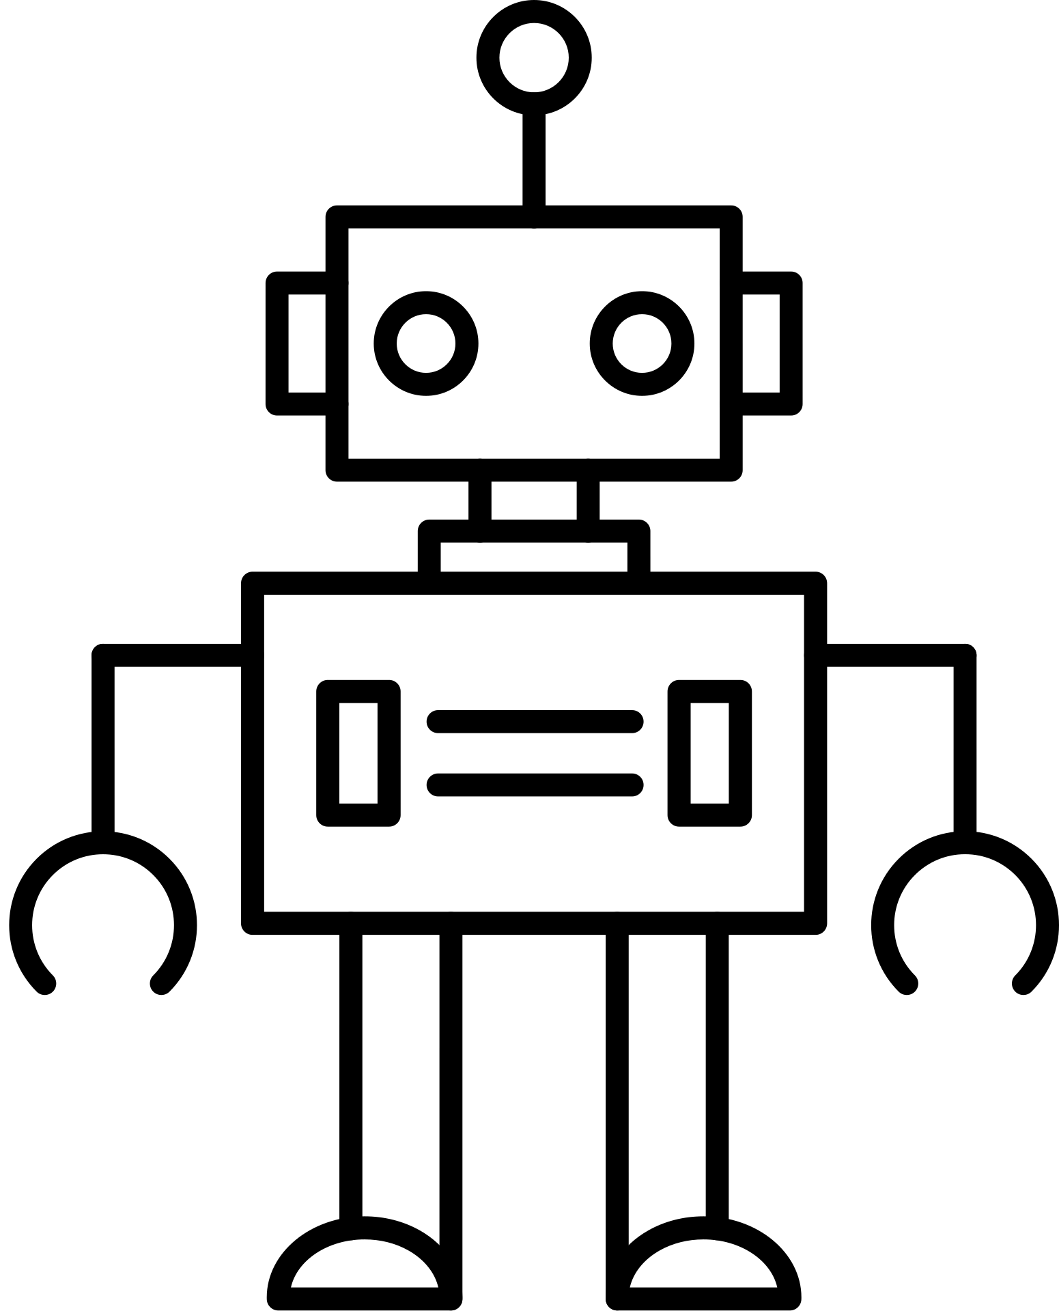



Fetch URL
Check available scrappers
Request sent to
flask server
Website Specific
Scrapper
General
Scrapper
Our Proposed Solution
We aim to develop a universally compatible browser extension that leverages NLP, CNN and OCR technologies to identify and inform users of dark patterns on sites they visit so that they can make informed decisions.
Classify text snippets
using roBERTa
Segment image snippets
and create bounding box
Send results to user client/extension and highlight the identified dark patterns.
Localize and mark UI
dark patterns using CNN.

Slide 4
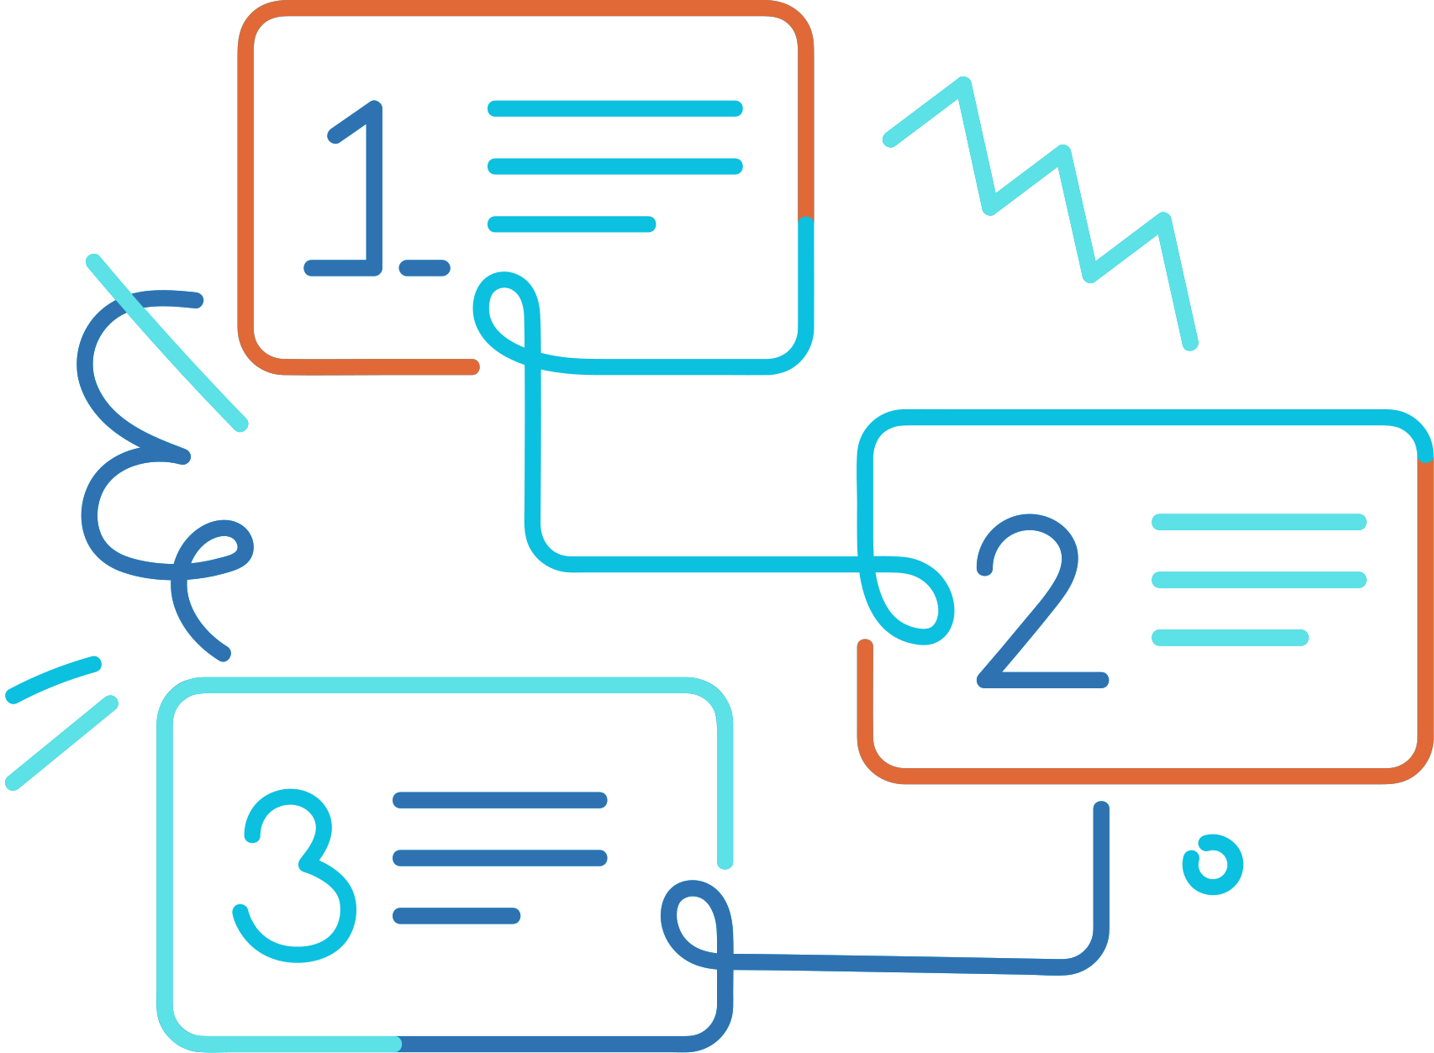
Solution Workflow
01
02
03
04
Web Scrapping and data storage.
Preprocessing on data done for removing reduncancies.
Data sent to the ML Model using the flask server.
Labelling assigned to dark patterns.
The output data from the ML Model sent to the extension using flask server and the prompt displayed to the user.
Feedback for ML Model collected and used to fine tune the model.

Slide 5
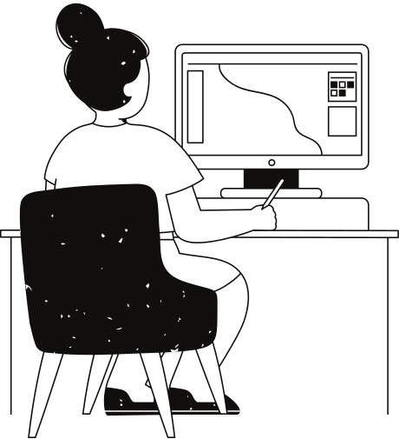
What is different in this?
Dynamic Iterative Learning
Our dynamic extension evolves continuously with user feedback, learning from mistakes and adapting to emerging deceptive tactics in real-time.
2.Holistic User Empowerment:
Our tool not only identifies dark patterns but also empowers users by offering actionable insights and user-friendly solutions, such as simplifying subscription cancellations with tailored suggestions.
3.Privacy-Centric Design:
Respecting user privacy is at the core of our design. Our extension analyzes patterns locally on the user's device, minimizing the need to transmit sensitive data to external servers. This approach not only enhances user trust but also ensures a secure browsing experience.

Slide 6
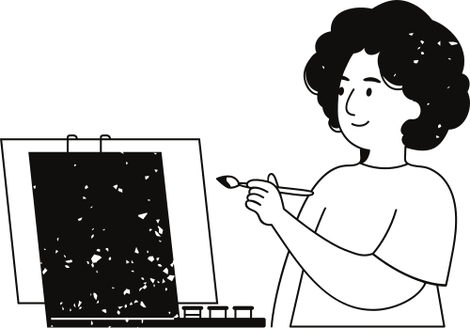

Future scope
Detection Models:
Focus on refining accuracy and exploring alternative model combinations.
Implementing deep-learning models for Dark-Pattern identification.
Image/UI-based Dark Pattern:
This is a problematic classification.
So, we are working on utilizing CNN for image-based patterns and leveraging OCR for text in images/UI.
Reliability enhancements:
Continuous model refinement.
Generalizing web scrapping workflow.

Slide 7
Additional features planned-
We plan to add an extra feature which users can use to keep count of active subscriptions.
We aim to integrate a chatbot that educates users in-depth about detected dark patterns, fostering awareness about their prevalence and impact on user behavior.
At last, we tend to enhance the extent of intent recognition of the text in order to make the predictions less erroneous.

Slide 8
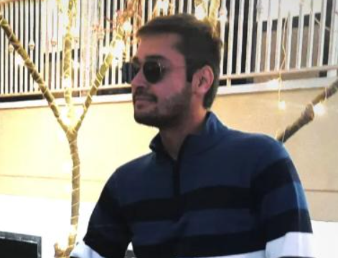
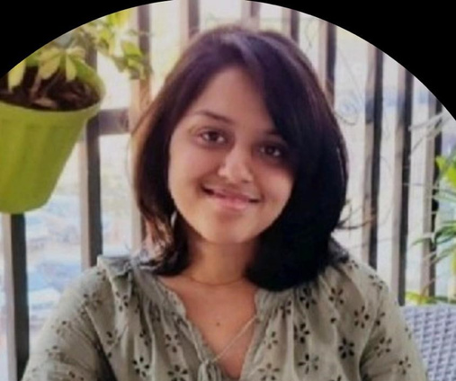

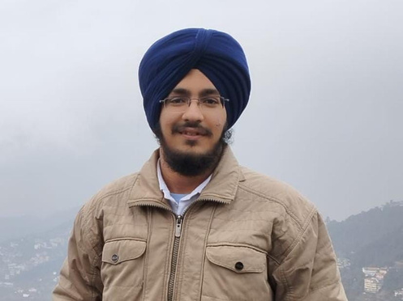
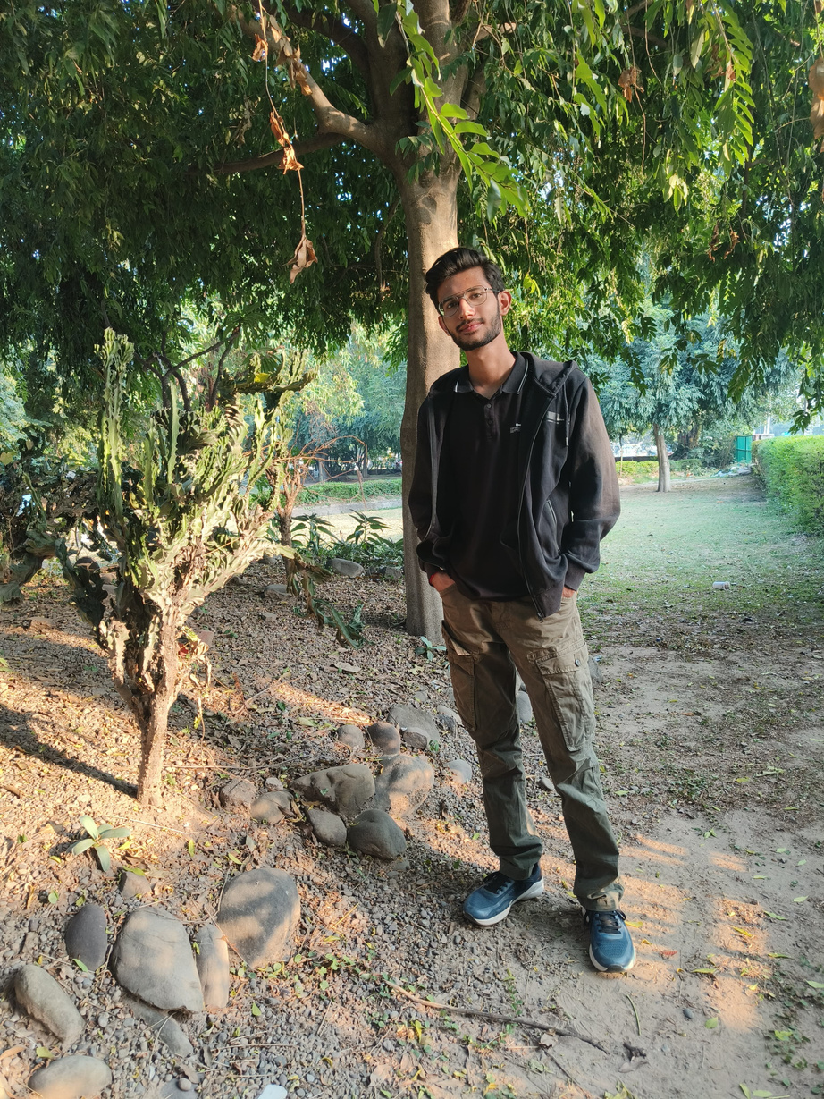

The Team
TEAM LEADER
Pranav Sharma
Akanksha Narula
Gaurav Gupta
Gurmehar Singh
Arnav Singh
Link to the GitHub repository

Slide 9
Thank you very much!

